Slide 1
Practical POSTMAN
Do stuff!
150 hours of testing: theme 2: Headless

Slide 2
SETTING UP your local test environment
Note: The default installation folder for any and all tools \ training materials should be C:\DEV to make them easy to find again. You will thank me for this one day.
Install GIT to be able to save your code a GIT repository. This process and the related terminology is described here: http://newcoder.io/begin/save-your-progress/
Install Postman: https://www.getpostman.com/apps
Bookmark the latest Pet store JSON file: https://github.com/OAI/OpenAPI-Specification/tree/master/examples/v2.0
(The expanded file will give the most functions for testing)
Bookmark the online swagger editor: http://editor.swagger.io//#/
View the Pet store file in RAW version and paste the code into the Swagger editor

Slide 3
SETTING UP your local test environment
A note on viewing APIs in POSTMAN.
You can also download the Pet store JSON file into Postman but going through Swagger gives you a nicer interface to see the requests supported by the API. It’s entirely up to you how you set up your environment.
If you do not have access to the Swagger file (in JSON/YAML format) to be tested. You can view the webpage in Chrome developer tools and paste the curl requests directly into POSTMAN.
A note on dropping Swagger files into Postman: The Postman swagger import doesn't read all of the internal objects which means that some request bodies will be incomplete so if possible, it is best not to build your requests UI in this way. To address this problem, Postman have brought out a new open source converter which can be added to your Postman installation: http://blog.getpostman.com/2018/03/02/sync-your-specs/

Slide 4
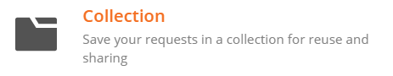


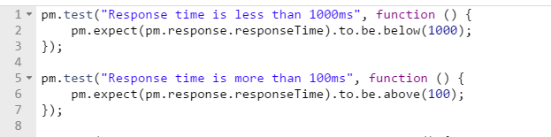
create YOUR COLLECTION
A collection is a bucket that holds requests Tests live “under” requests Running a request gets a response = Status + Time + Size + Header + Body (GET, POST, PUT, DELETE)
Tests verify the correct parts are returned in a response
At the very least tests should verify: SLA, Response code + Response body
Response
Test

Slide 5
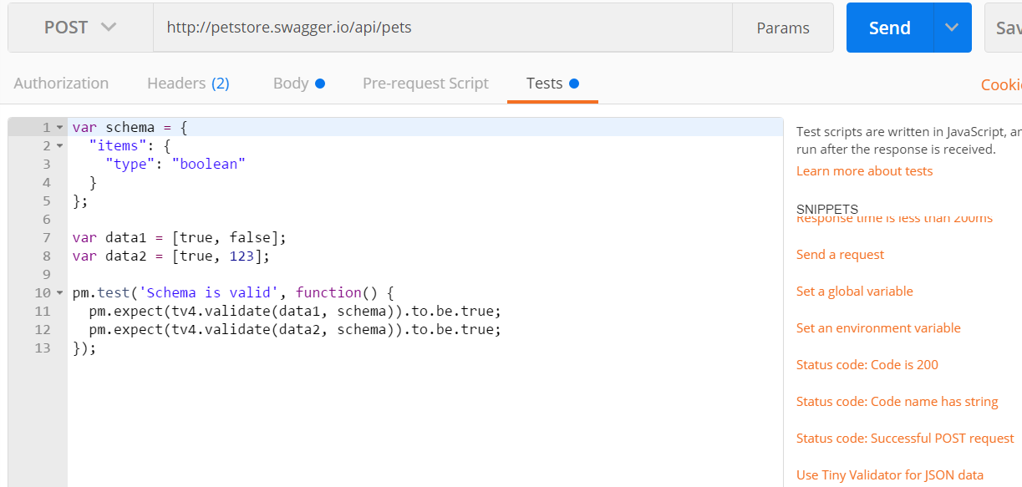
Adding a pre-canned test- Validate json
Go to the tests tab and select another one of the orange pre-canned tests and edit the code to change the context

Slide 6
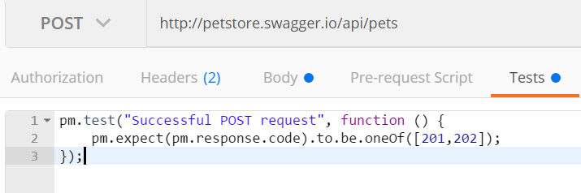
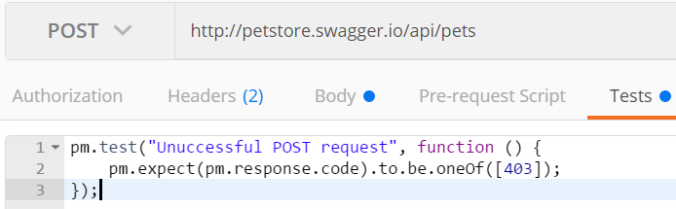
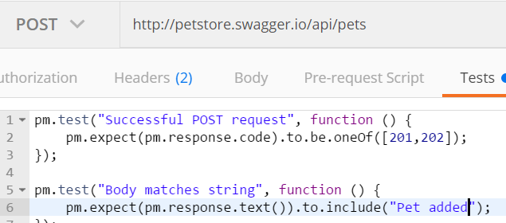
Example verifications
Positive responses to GET, POST, PUT, DELETE requests GET a pet that exists
Negative responses to GET, POST, PUT, DELETE requests PUT a pet that does not exist
Message body contains string / integer /integer + string Test for a string being returned Test for a string not being returned

Slide 7
run AND FIX some TESTS
Some homework: (Should take about 20 mins – you can all work together to complete this)
Create a request for each status type and add tests.
Fix the failed tests (look at the test title to figure out the purpose)
Save your tests into GIT and send me the URL.
Request URLs for status:
GET http://petstore.swagger.io/v2/pet/findByStatus?status=available
GET http://petstore.swagger.io/v2/pet/findByStatus?status=pending
GET http://petstore.swagger.io/v2/pet/findByStatus?status=sold
(I’ve changed the default snippet names to make them a bit more meaningful)
Tests: https://github.com/ElizaTWF/150-Hours-of-testing
(JSON file) https://github.com/ElizaTWF/150-Hours-of-testing
Saving the collection to GIThub: Saving a Postman collection to GIThub.

Slide 8
More reading:
Introduction to REST Requests
Testing GET Requests
Testing POST Requests
Testing PUT Requests
Testing PATCH Requests
Creating a Postman Collection
Building workflows - Postman

